Slide 1
E-STUDENT CARD
(Summer Project)
Mahima S - 2022115018
Kavitha E -2022115022
Guided By:
Dr .M . Deivamani
Assistant Professor

Slide 2
INTRODUCTION
Managing student identification and academic records using traditional physical cards presents several challenges.​
​
Physical cards are vulnerable to damage, theft, and loss, which can result in security concerns and inconvenience .
​
Further complicates the process of maintaining and updating records, making it inefficient for both students and administrative staff to access and manage academic information in a timely manner.​​​
Difficulties in managing large volumes of student data efficiently using paper-based systems, leading to delays and errors. ​

Slide 3
Problem Definition
Project aims to streamline the process of managing student identification and academic records, while also connecting students with their faculty advisors.
Providing Digital solution for storing and accessing informations like student identification details, academic information, and other relevant data .
​Students can fill in their details, which are accessible to faculty advisors for verification and management purpose.
It offers a convenient and secure way for students to share their information and for institutions to manage student data efficiently.

Slide 4
OBJECTIVE
To Develop a secure and efficient digital platform for managing student Information and academic records.
To Replace traditional physical cards with a feature-rich digital solution.
To Enable seamless access to identification details and academic information for students.
To Facilitate communication between students and their faculty advisors.
To Eliminate risks associated with physical cards, ensuring faster, paperless data management.

Slide 5

IDEAS
The Student E-Card project emerged from the need to digitalize and simplify the management of student identification and academic records.
Digital Replacement for Physical Cards: Develop a secure digital e-card system with three levels of authentication: student, faculty, and admin.
Improved Access for Faculty: Enable faculty to easily access and manage student records, including academic performance and personal details, through their authenticated accounts.

Slide 6
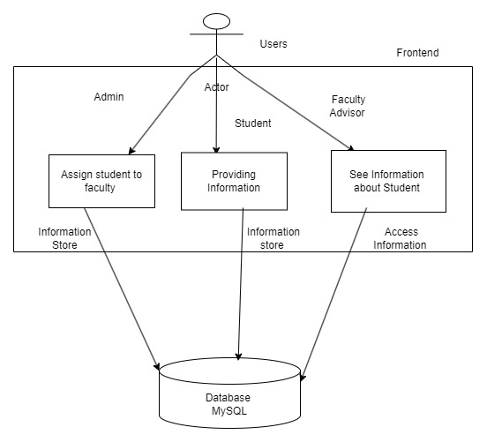
Diagram
System Architecture

Slide 7
The architecture consists of the following key components:
1.Frontend (User Interface):
Student Interface: Students input their identification and academic information.
Faculty Interface: Faculty advisor access and review student information, tracking progress.
Admin Interface: Administrators assign students to faculty advisors via admin authentication.
2. Backend (Server-side Application):
Data Management: Handles data processing, authentication, and database communication.
Built with Python: Manages requests, controls data flow, and ensures secure communication across the system.

Slide 8
3. Database (Data Storage):
MySQL Database: Securely stores all student-related data in a more structured way which will be efficient for accessing.
Efficient Storage: Data is easily retrievable for faculty advisor authentication and other system processes.
4.Security (Data Protection):
Role-Based Access Control: Ensures only authorized users (students, faculty, admin) can access specific data.

Slide 9
Design
1. Home Page:
Main page as contain About, Contact Details, Feedback Form and Login for students, faculty, and administrators.
Users can Sign Up or Sign In ( Change password , Forget Password )
2. Student Interface:
After signing in, students are prompted to fill in their personal information, which includes basic details like contact information and family details.
Enter their semester results, updating the system for each academic term

Slide 10
Additionally, students can provide information regarding:
Scholarship Details
Project Details
Papers Published
Higher Studies Plans
Placement Information
Any Additional Exam Detail
3. Faculty Interface:
Faculty main page displays a list of students assigned for them in an organized way by using academic year.
Faculty members can click on a student’s name to view detailed information fetched from the database, including academic records and marksheets.
Faculty can also search for students using a search bar by entering the student’s roll number.

Slide 11
Features :
Analysis :
List the total number of pass students and the total number of fail students, shown in a pie chart.
In the graph display the total number of pass and fail students by semester and with the rollnumber.
Marksheet Authorization:
To authorize the student's marksheet, ensuring it is valid and approved.
Lock/Unlock Marksheet:
Faculty can lock the marksheet after authorization to prevent further changes.
Unlocking allows edits if needed before final approval.

Slide 12
4. Administrator Interface:
Navigation (Previous/Next Buttons):
navigate between student records, viewing one student’s information and moving to the next or previous assigned student using "Previous" and "Next" buttons.
The admin section allows for bulk data management, where administrators can upload an Excel file containing the following student details:
Student Name
Roll Number
Email
Phone Number
Faculty Advisor Name and Id

Slide 13
Faculty Credentials Management: ​
​
The admin is responsible for registering and managing the login credentials for faculty members.
Analysis:
Display the number of passes and failures in a pie chart, highlighting the number of failures prominently.

Slide 14
Frontend
⁠Tools and Technologies used
HTML5: Create the structure and layout of the web pages, facilitating organized content presentation.
CSS3: Styling the user interface, ensuring a visually appealing design and a responsive layout across various devices.
JavaScript: Add dynamic features, enhance client-side interactivity, and validate user information, ensuring data integrity before submission.
Backend
Python: The primary programming language used for backend development.
Database
MySQL: A relational database management system used to store student-related data, including identification details and academic records.

Slide 15
Development Tools:
Visual Studio Code:
The code editor used for writing and managing the project code
XAMPP:
A software package that provides a local server environment for developing applications. It is used for database management, enabling easy access to MySQL for storing and managing data.
PyCharm Community Edition 2023.3.3:
An integrated development environment (IDE) primarily used for Python programming

Slide 16
Results and Discussions
Project Demo :
https://drive.google.com/file/d/1-8gP98BaSexgXue0LGeA4AKIxVwMaBds/view?usp=drivesdk
Results and discussions
System Functionality:
Developed and implemented, allowing students, faculty advisors, and administrators to interact seamlessly through the web application.
Key features, such as student registration, information management, and faculty access to student records, were tested and verified to function as intended.

Slide 17
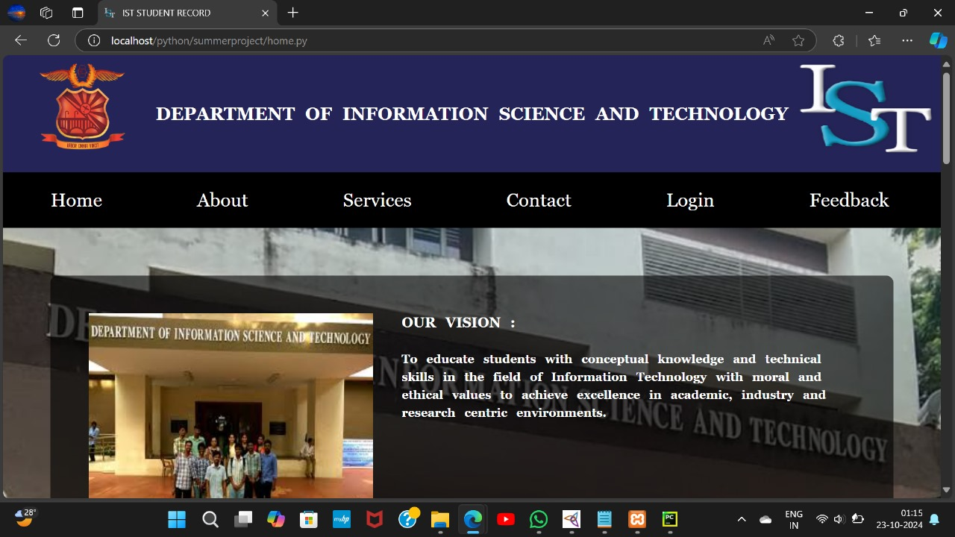

Slide 18
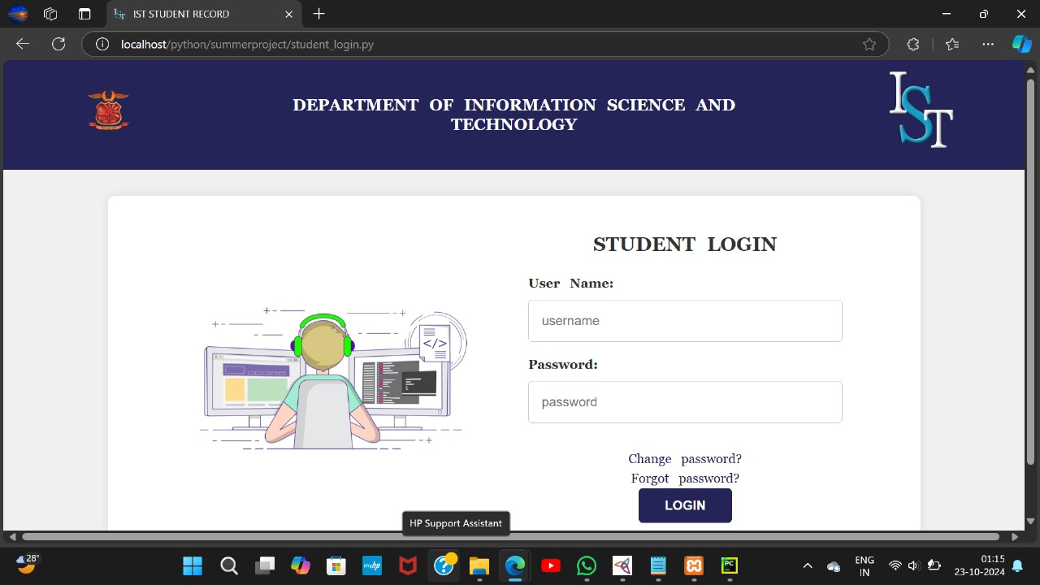

Slide 19
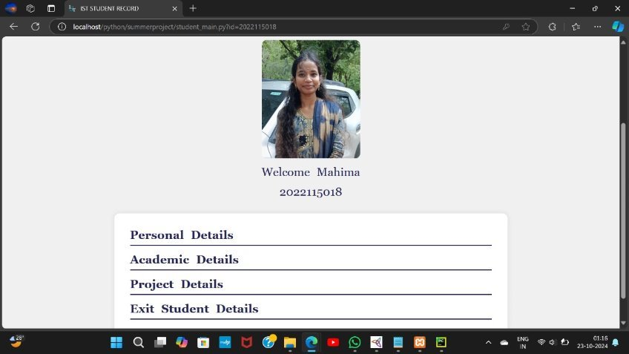

Slide 20
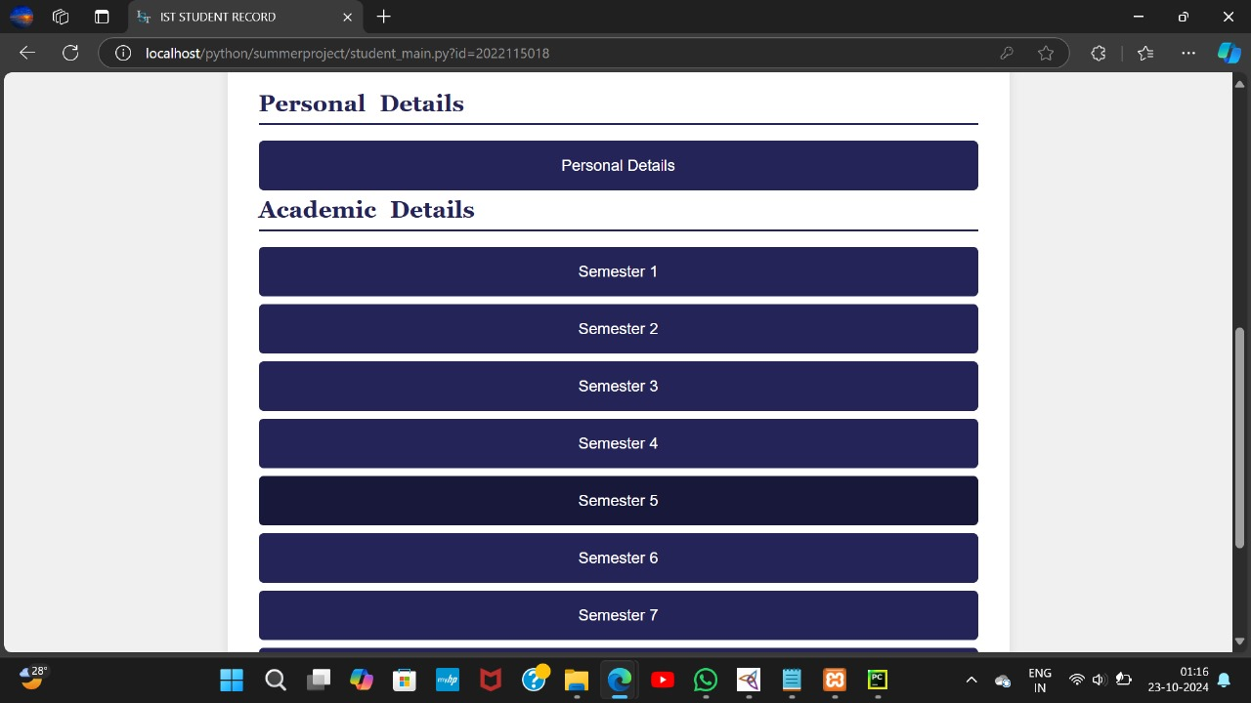

Slide 21
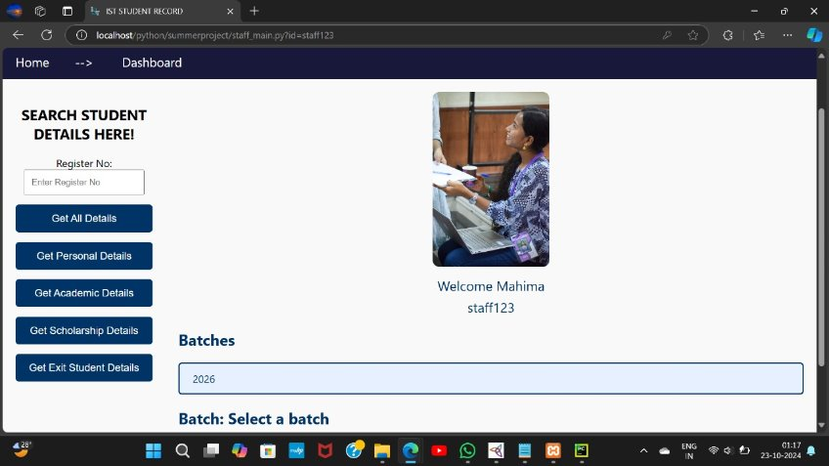

Slide 22
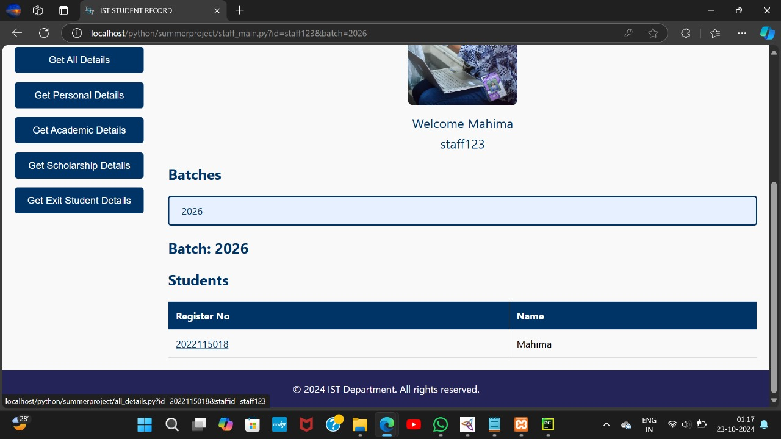

Slide 23
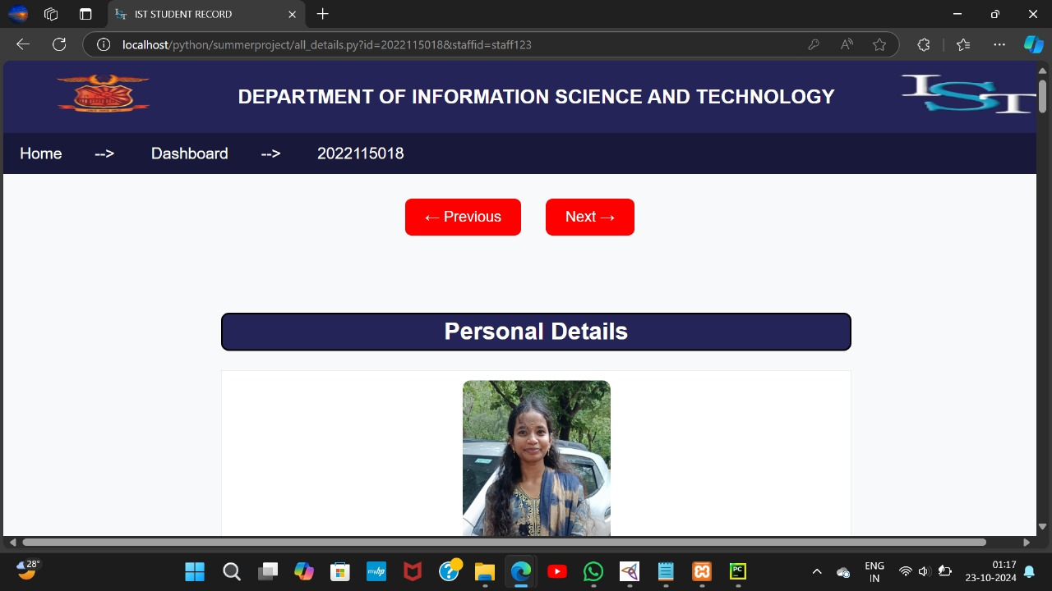

Slide 24
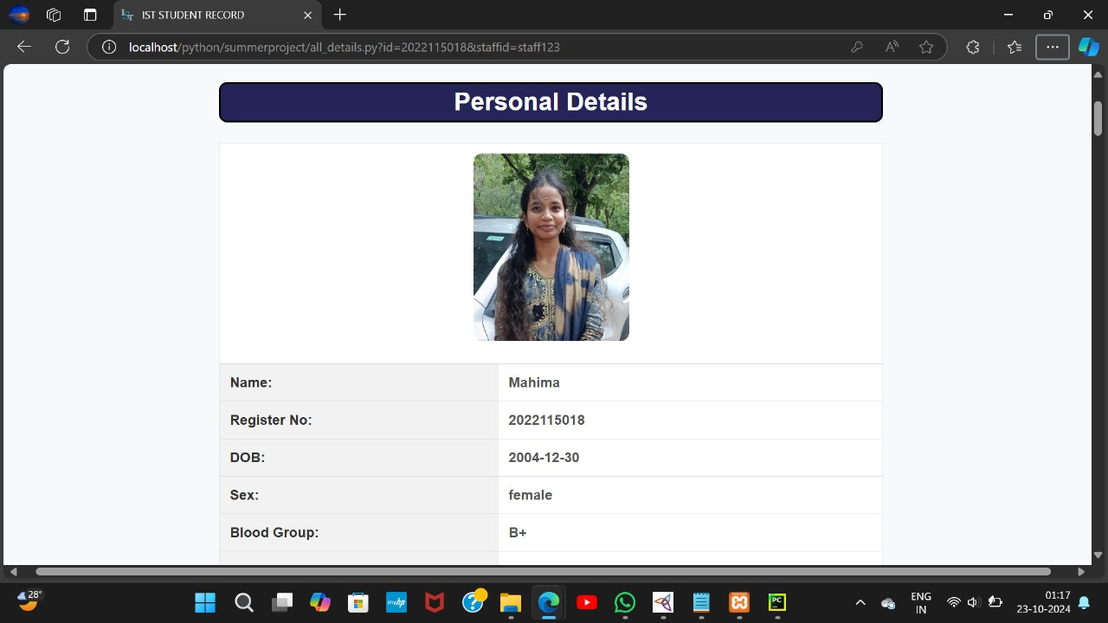

Slide 25
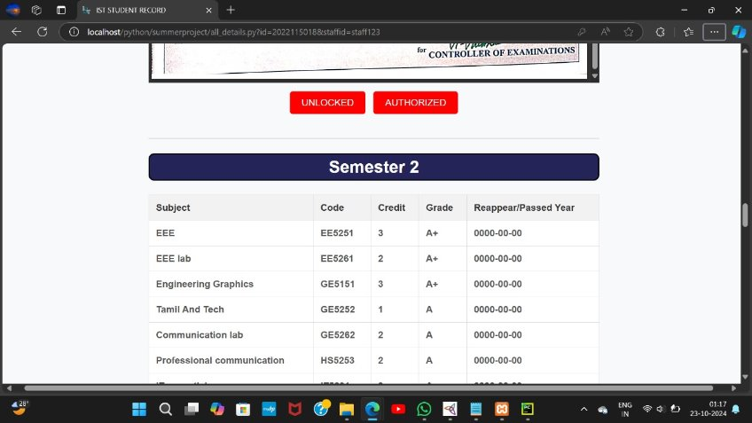

Slide 26
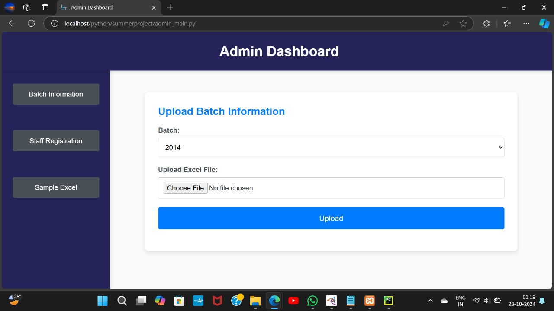

Slide 27
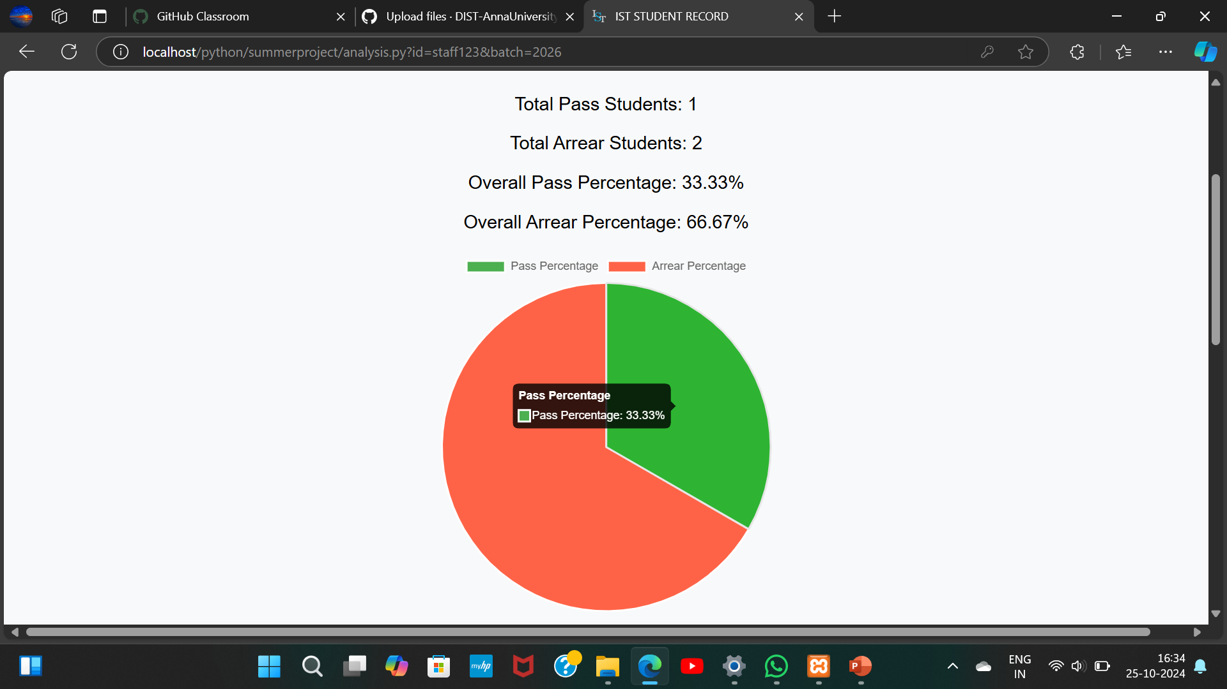

Slide 28
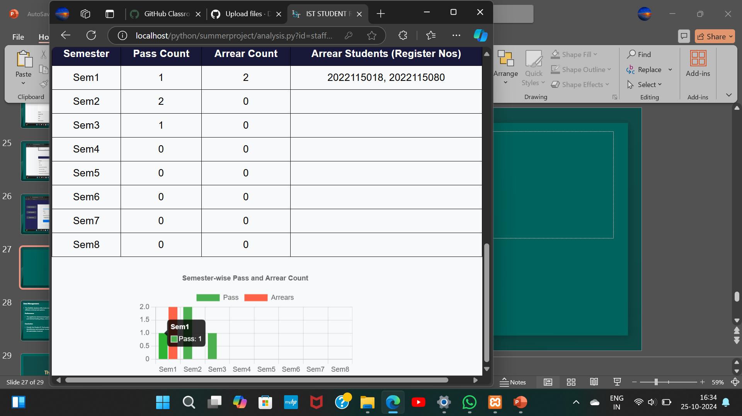

Slide 29
Data Management:
The MySQL database effectively stored and managed all student-related data, allowing for efficient retrieval and updates.
Performance:
The application demonstrated good performance with quick response times for user requests and minimal loading delays, even with multiple concurrent users.
Conclusion:
Overall, the Student E-Card project successfully meets the objectives of improving student identification and academic record management while offering a user-friendly experience for all stakeholders involved.

Slide 30
Thank You

